Slide 1
Overview of 320, 485US and 524
A visual (re)view of statistical tests

Slide 2
Measured variables: Univariate
That means one outcome variable

Slide 3
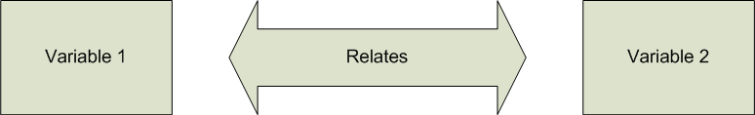
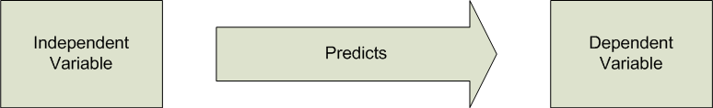
Types of Relationships: Measured Variables
Correlation, Chi-square
One IV and One DV: Regression (regular, logistic and multilevel), t-tests, One-Way Analysis of Variance (ANOVA; Between and Within; Random Effects)

Slide 4
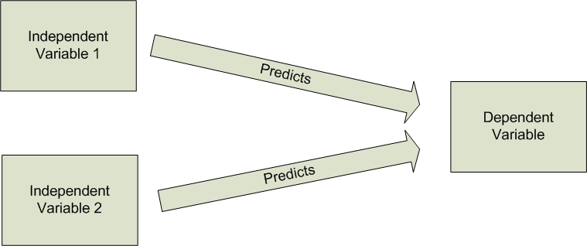
Types of Relationships: Measured Variables
Multiple IVs and single DV: Multiple Regression (regular, logistic and multilevel), Analysis of Covariance (ANCOVA)

Slide 5
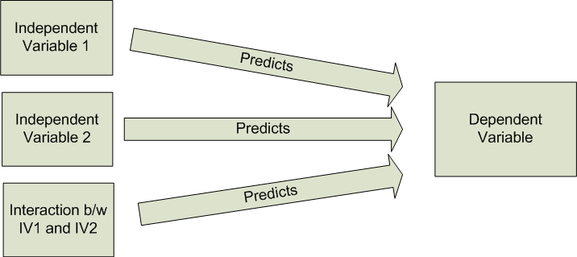
Types of Relationships: Measured Variables
Multiple IVs with interaction (moderation) and a single DV: Multiple Regression (regular, logistic and multilevel), Factorial ANOVA (Between, Within, Mixed) or ANCOVA

Slide 6
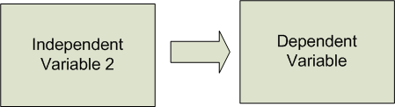
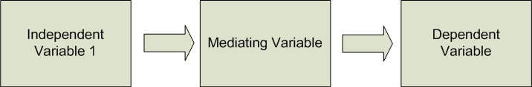
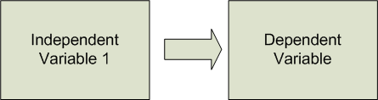
Types of Relationships: Measured Variables
An IV indirectly effects a DV through an intervening variable: Mediation

Slide 7
Measured variables: Multivariate
That means more than one outcome variable

Slide 8
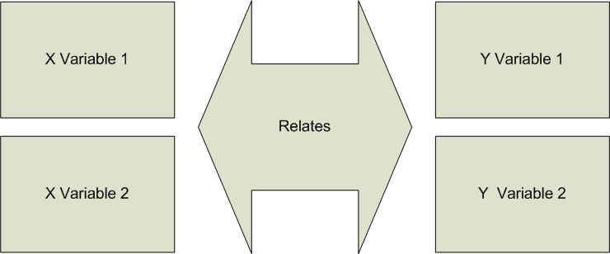
Types of Relationships: Measured Variables
2 sets of Variables: Canonical Correlation (AKA, multivariate multiple regression, set correlation)

Slide 9
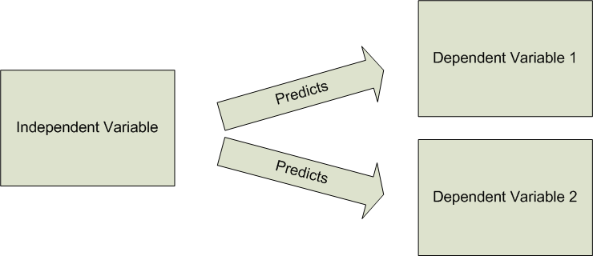
Types of Relationships: Measured Variables
A single IV and multiple DVs: Tau squared, Multivariate Analysis of Variance (MANOVA), Profile Analysis
If the arrows are reversed, Discriminant Function analysis

Slide 10
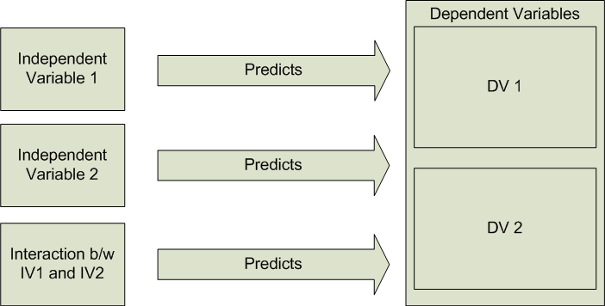
Types of Relationships: Measured Variables
Multiple IVs with interaction (moderation) and a multiple DVs: Factorial MANOVA or MANCOVA, Profile Analysis

Slide 11
A glimpse at Latent Variable Models
Latent means hidden or unseen

Slide 12
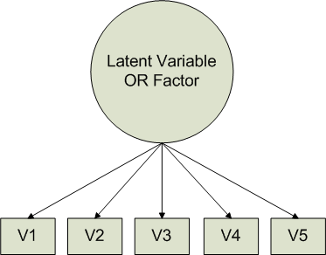
Types of Relationships: Latent Variables
Multiple Measured variables indicating a latent “factor”: Principal Components Analysis, Factor Analysis

Slide 13
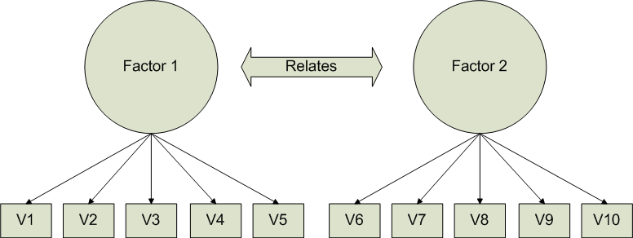
Types of Relationships: Latent Variables
Multiple Correlated Factors: Canonical Correlation, Factor Analysis, Structural Equation Modeling

Slide 14
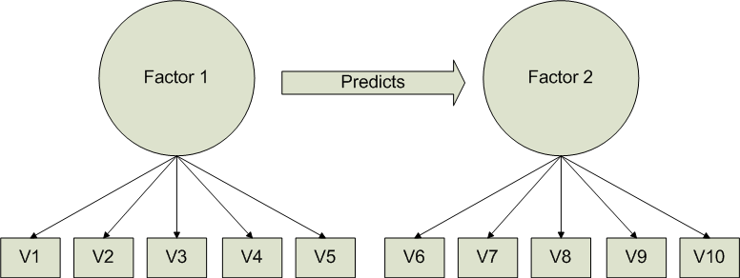
Types of Relationships: Latent Variables
Multiple Correlated Factors: Structural Equation Modeling, Latent Variable Regression

Slide 15
What was covered in 320?
“Apparently not much”

Slide 16
Types of Relationships in 320?
Correlation, Chi-square
One IV and One DV: Regression, t-tests, Between and Within Groups One-Way Analysis of Variance (ANOVA; Between and Within)

Slide 17
Types of Relationships in 320?
Multiple IVs with interaction (moderation) and a single DV: Factorial Between Groups ANOVA

Slide 18
That’s it??
Seriously, that’s it?
Plus descriptives, probability and some other stuff

Slide 19
What was covered 485US?
“Just a bit more and more of the same”

Slide 20
Types of Relationships in 485US?
One IV and One DV: Regression, One-Way Analysis of Variance (ANOVA; Between and Within; Random Effects)

Slide 21
Types of Relationships in 485US?
Multiple IVs and single DV: Multiple Regression, Analysis of Covariance (ANCOVA)

Slide 22
Types of Relationships in 485US?
Multiple IVs with interaction (moderation) and a single DV: Multiple Regression, Factorial ANOVA (Between, Within, Mixed) or ANCOVA

Slide 23
That’s it?
Yep.
Kinda hard to believe, huh?

Slide 24
What about 524?
“Same stuff more variables”

Slide 25
Types of Relationships in 524?
Multiple IVs and single DV: Multiple Regression (regular, logistic, multilevel), Analysis of Covariance (ANCOVA)

Slide 26
Types of Relationships in 524?
2 sets of Variables: Canonical Correlation (AKA, multivariate multiple regression, set correlation)

Slide 27
Types of Relationships in 524?
A single IV and multiple DVs: Tau squared, Multivariate Analysis of Variance (MANOVA), Profile Analysis
Plus discriminant function analysis

Slide 28
Types of Relationships in 524?
Multiple IVs with interaction (moderation) and a multiple DVs: Factorial MANOVA or MANCOVA, Profile Analysis

Slide 29
Types of Relationships in 524?
Multiple Measured variables indicating a latent “factor”: Principal Components Analysis, Factor Analysis

Slide 30
Types of Relationships in 524?
Multiple Correlated Factors: Canonical Correlation, Factor Analysis

Slide 31
Why Multivariate?
OR “Is this really necessary?”

Slide 32
Why multivariate statistics?
Reality
Univariate stats only go so far when applicable
“Real” data usually contains more than one DV
Multivariate analyses are much more realistic and feasible

Slide 33
Why multivariate?
“Minimal” Increase in Complexity
More control and less restrictive assumptions
Using the right tool at the right time
Remember
Fancy stats do not make up for poor planning
Design is more important than analysis

Slide 34
When is MV analysis not useful?
Have a specific, univariate hypothesis? Use a univariate statistic
Test individual hypotheses univariately first and use MV stats to explore
The simpler the analyses the more powerful

Slide 35
Parallels to previous material
Psy320 and Psy485US |  | Psy524
General Linear Model | → | Same (most of the class is based GLM)
Linear Regression | → | Multiple Regression; Logistic Regression
Correlation | → | Canonical Correlation
t-test | → | Tau-Squared; Discriminant Function Analysis (DFA)
Between Groups ANOVA | → | Between Groups MANOVA; DFA
ANCOVA | → | MANCOVA
Repeated Measures ANOVA | → | Profile Analysis
Mixed ANOVA | → | Profile Analysis
Random Effects ANOVA | → | Multilevel Modeling
No Parallels to Previous Material
 |  | Data Screening
 |  | Factor Analysis

Slide 36
What you’re assumed to already know
OR here’s a list of things you may want to check out if you haven’t seen them before or review if you have

Slide 37
Things you should know (or need to review)
Types of variables – Independent, Dependent, Extraneous, Confounding
Univariate, Bivariate vs. Multivariate
Continuous vs. Discrete vs. Dichotomous
Levels of Measurement
Orthogonal vs. Correlated
Sums of Squares vs. Sums of Cross-Products
Variance vs. Covariance

Slide 38
Things you should know (or need to review)
Descriptives – Proportions, Probability, Percentiles, Central Tendency, Variability
Shapes of Distributions – Symmetric, Skewness, Kurtosis
Inferential Statistics – Sample vs. Population, Standard Deviation vs. Standard Error
Type 1 vs. Type 2 Error and Power
Z and t-tests
ANOVA – Between and Within Subjects; One-way vs. Factorial
Effect Size – Eta-squared and Partial Eta-squared

